Slide 1
Water in Ecosystems
School/program name
Date

Slide 2
Background Information (for facilitator)
Water ecosystems include rivers, streams, ponds, lakes, marshes, estuaries, and oceans. Marshes are sometimes referred to as wetlands.
Each water ecosystem has different kinds of water. Water can be classified as fresh, salt, or brackish (both salt and fresh). The movement of the water also helps to define the water ecosystem. Some waters move in waves, other waters flow, while some do not move at all.
Each water ecosystem also has different kinds of organisms that live there. These organisms are specially suited for their environment. Physical adaptations help them survive. Some also have the ability to alter their environment to meet their needs. Humans are organisms that have learned to change their environment to meet their needs. However, some of these changes come at the expense of other organisms. We are learning the importance of protecting these water ecosystems.

Slide 3
Agenda
Opening (30 minutes)
Setting the Stage (30 minutes)
Activity: Building an Aquarium Terrarium – Setting up the Aquarium (45 minutes)
Break (15 minutes)
Activity: Watersheds (45 minutes)
Activity: It’s All Downstream (45 minutes)
Lunch (30 minutes)
Recess: The Great Jungle Fire (30 minutes)
STEMtastic Careers (30 minutes)
Activity: Building an Aquarium Terrarium - Assembly (45 minutes)
Mind Snacks (15 minutes)
Cyber Investigation: Go Fishing – Thrill of the Catch (45 minutes)
STEM Camp Notebook Reflection (10 minutes)
Wrap Up (5 minutes)
Dive Into Digital Project (60 minutes)

Slide 4
Learning Objectives
To identify varying water ecosystems
To explain that water is a vital, natural resource
To determine reasons that can stress the water supply

Slide 5
Today’s Vocabulary
Ecosystem
Watershed
Salt Water

Slide 6
Setting the Stage

Slide 7
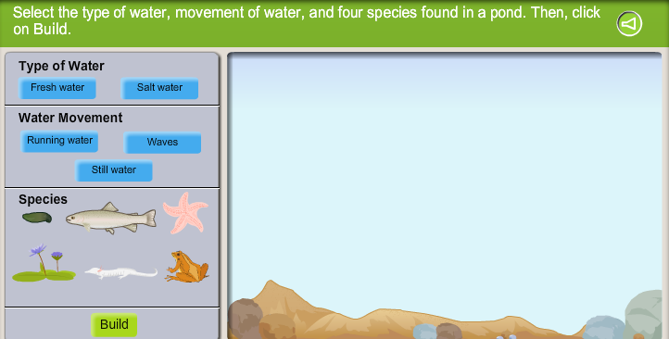
Why are certain species more suitable for a particular ecosystem?
Exploration: Water Ecosystems
Notes:
Show students an actual glass of water (or water filled bottle). Ask students if they know how long they can go without drinking water. Generate a list of the answers.
Show video segment Why Water Rocks (2:45). Tell students that today we are investigating why water is important to us, where it can be found, and how we use it.

Slide 8
Activity: Building an Aquarium Terrarium
Setting up the Aquarium
Notes:
Break students up into groups of three. Provide students with a piece of butcher paper long enough to trace the body of a student. Have one student in each group lay on the paper so that the teammates can trace his/her body. Have that same student weigh so that the team can calculate how many pounds of water would equal 70% of the body weight.
Provide teams with graph paper (in2 or cm2) that they can use to calculate the total area inside the body outline. The teams should then calculate 70% of that area and color in that portion of the outline.

Slide 9
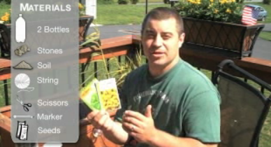
Setting up the Aquarium
Video: Intro
Notes:
Begin the activity by showing students the two video segments Part 1: Intro (3:56) and Part 2: Assembly (4:35). Then have students begin creating their aquarium as demonstrated in the second video segment. Detailed instructions are provided at Aquarium Instructions (English)/Aquarium Instructions (Spanish).

Slide 10
Activity: Watersheds
Notes:
Have students draw three columns in their STEM Camp Notebooks labeling each column K, W, L, respectively. Ask students to write down things they know about a watershed in the K column and things they wonder about a watershed in the W column. Instruct campers to fill in the W column with things they learn about watersheds as they do the activity. Solicit responses from students about what they wrote in the K or W of the chart. After the discussion, play the video segment, Watersheds, Estuaries, and Wetlands, pause and play in appropriate places as a result of earlier discussion allowing students to add facts to their L column. Then have students write a definition of watersheds in their own words in their STEM Camp Notebooks, asking them to include examples and nonexamples.
Have students read We All Live Downstream. Consider introducing one of these reading strategies to support comprehension. Encourage students to revise their definition of watershed in their STEM Camp Notebooks and also include their answers to the question: What does the saying “We all live downstream” mean to you?
Follow up by playing the video segment Water Pollution (5:32), pausing at critical points and prompting students to answer questions about main ideas.

Slide 11
Activity: It’s All Downstream
Notes:
In this activity students will create a model of a watershed that includes Chesapeake Bay. They will then simulate the introduction of pollutants somewhere in the watershed and observe how pollutants can travel downstream and affect many different water resources. Detailed instructions are provided in Hands-on Activity: It’s All Downstream.

Slide 12
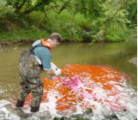
STEMtastic Careers
During today’s STEMtastic Careers, environmental scientists are the focus. Environmental scientists identify pollution and other environmental problems and design solutions. They figure out what is in the air, water, and soil to make sure that the environment is safe and minimize hazards to the health of the environment and population.

Slide 13
Activity: Building an Aquarium Terrarium
Assembly
Notes:
In this activity, students will finish creating their aquatic/terrestrial ecosystem they started making in the morning. Show the video segment Part 2: Assembly again, if needed, to assist students with assembly.

Slide 14
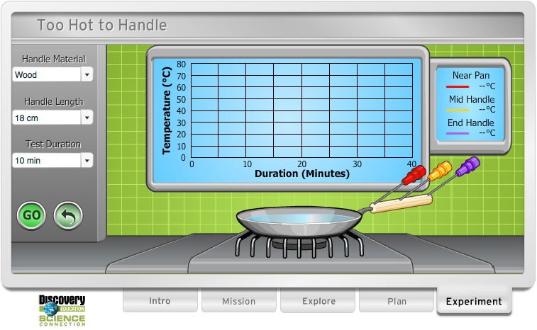
Mind Snacks

Slide 15
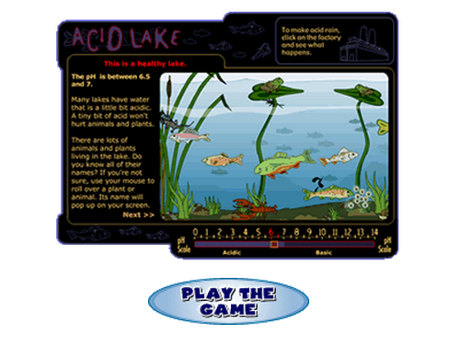
Cyber Investigation: Acid Lake
Notes:
In this virtual fishing investigation, students explore the pH level of a lake and the impact this has on living creatures within the ecosystem.
Have students working in small groups to explore the site. Discuss what factors may increase or decrease the pH levels within the students' aquarium terrariums.

Slide 16
Notebook Reflection
Describe a favorite memory involving water.
What is one way you can protect a local water ecosystem?
Give thoughts on becoming an environmental scientist. What is one problem that you may encounter and what are some possible solutions that you would want to try?

Slide 17
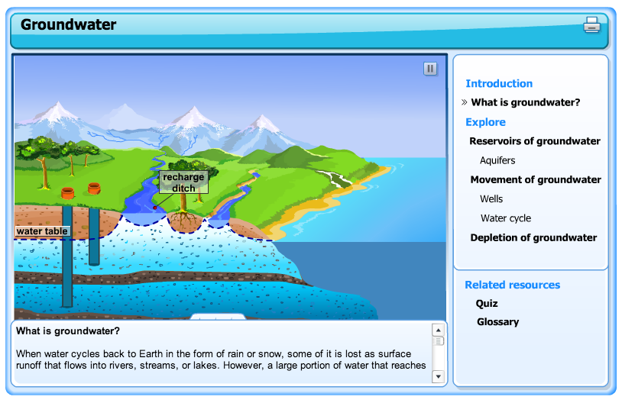
Wrap Up
Notes:
As a teaser that leads into the next day, direct students whole group through the
Skill Builder: Ground Water

